Slide 1
Ingredients Implementation
GROUP 4
Mustafa
Eric
Cao

Slide 2
MODELS:
Ingredient
IIngredientRepo
EFIngredientRepo
RecipeViewModel
Updated Recipe
Updated ApplicationDbContext
Updated SeedData

Slide 3
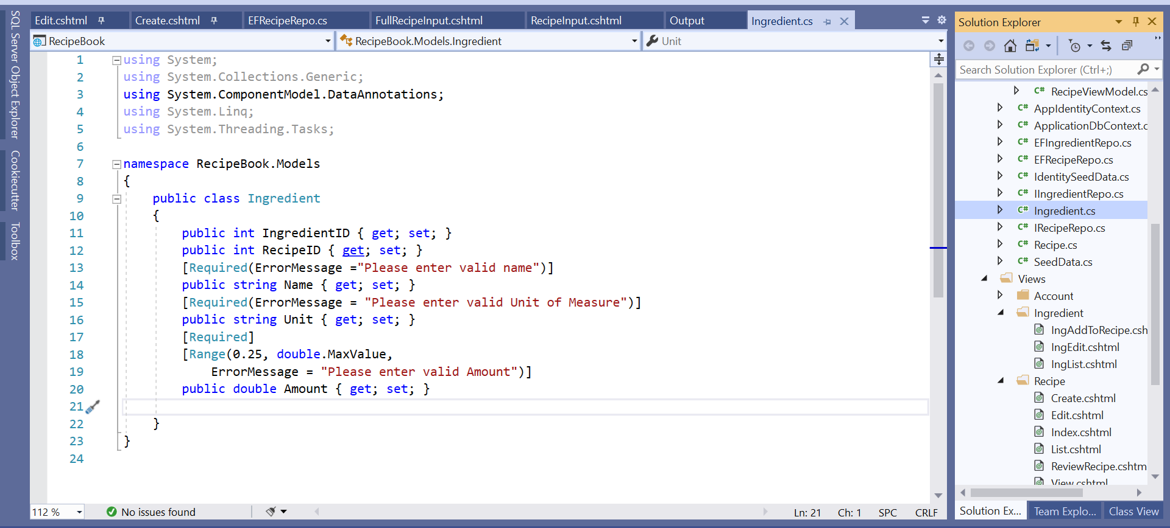
Ingredient:
Included RecipeID to associate with Recipe

Slide 4
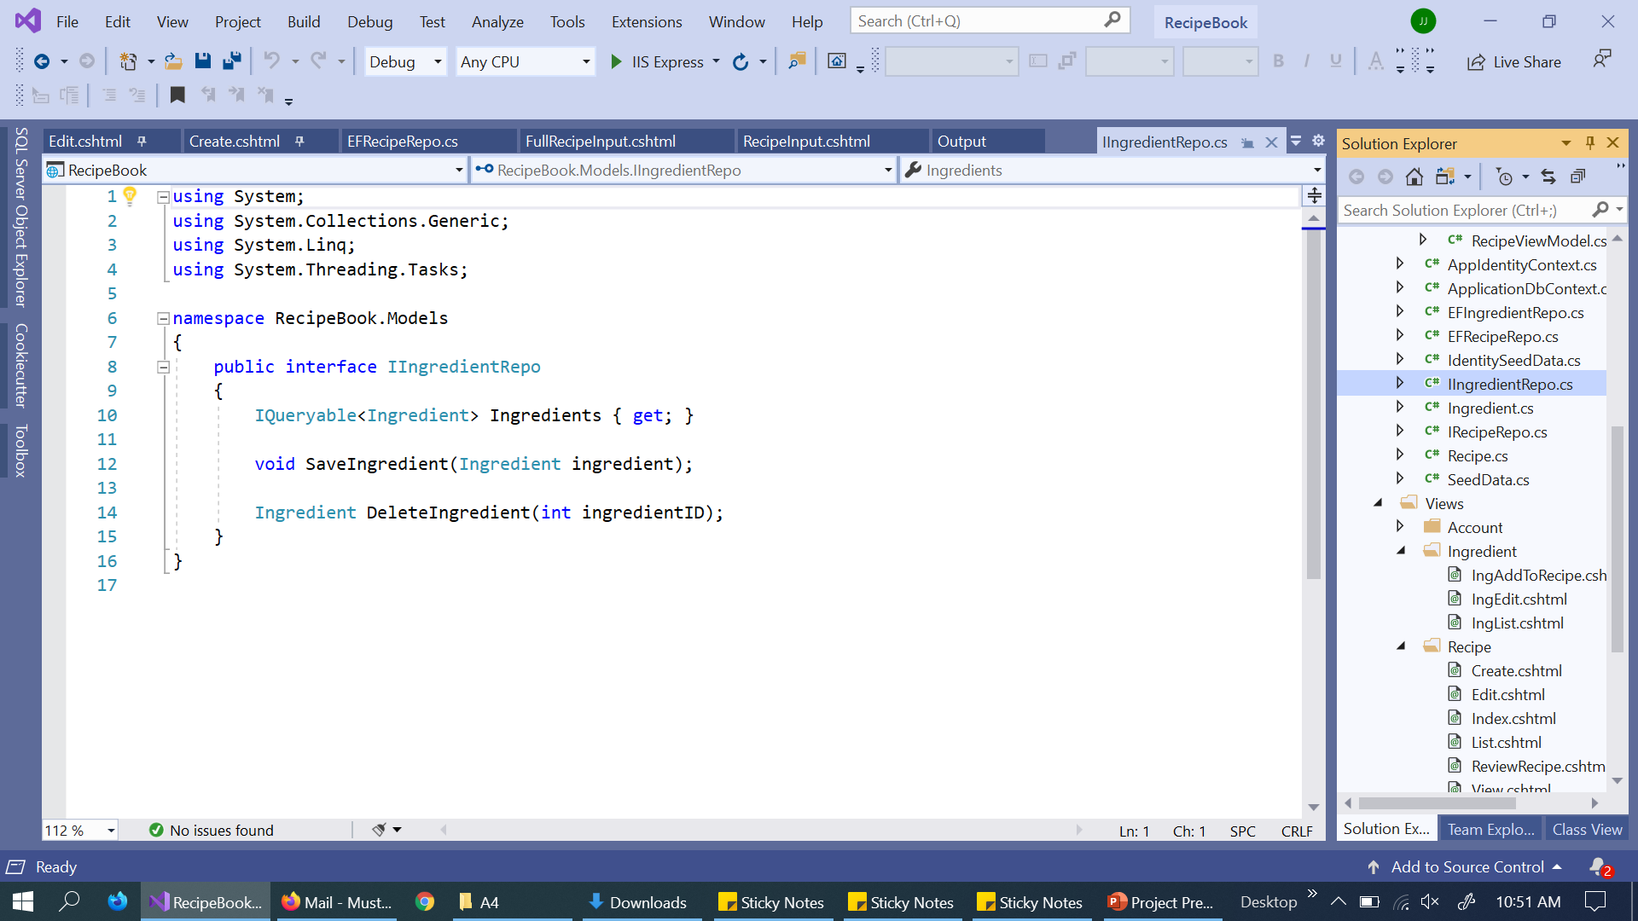
IIngredientRepo:

Slide 5
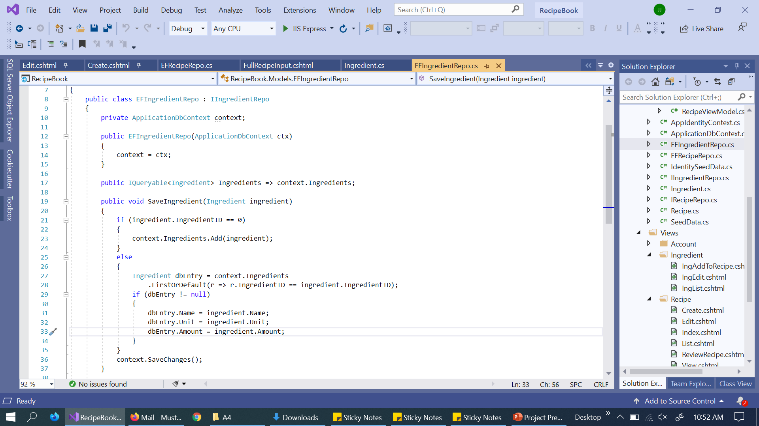
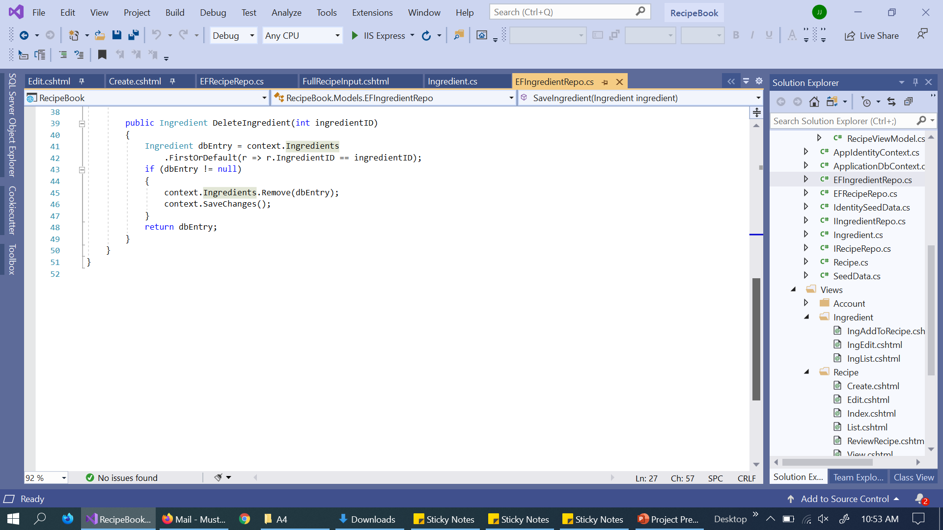
EFIngredientRepo:

Slide 6
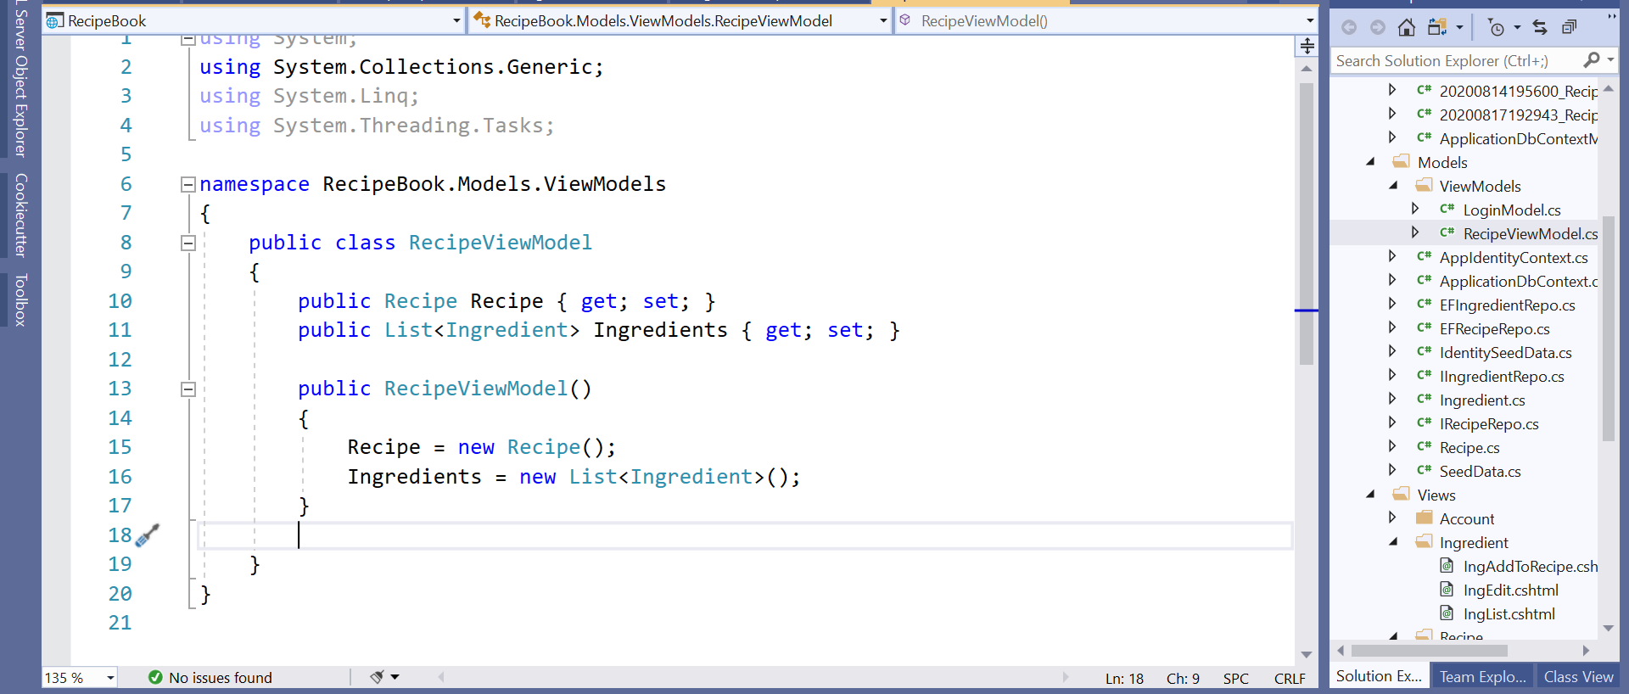
RecipeViewModel:

Slide 7
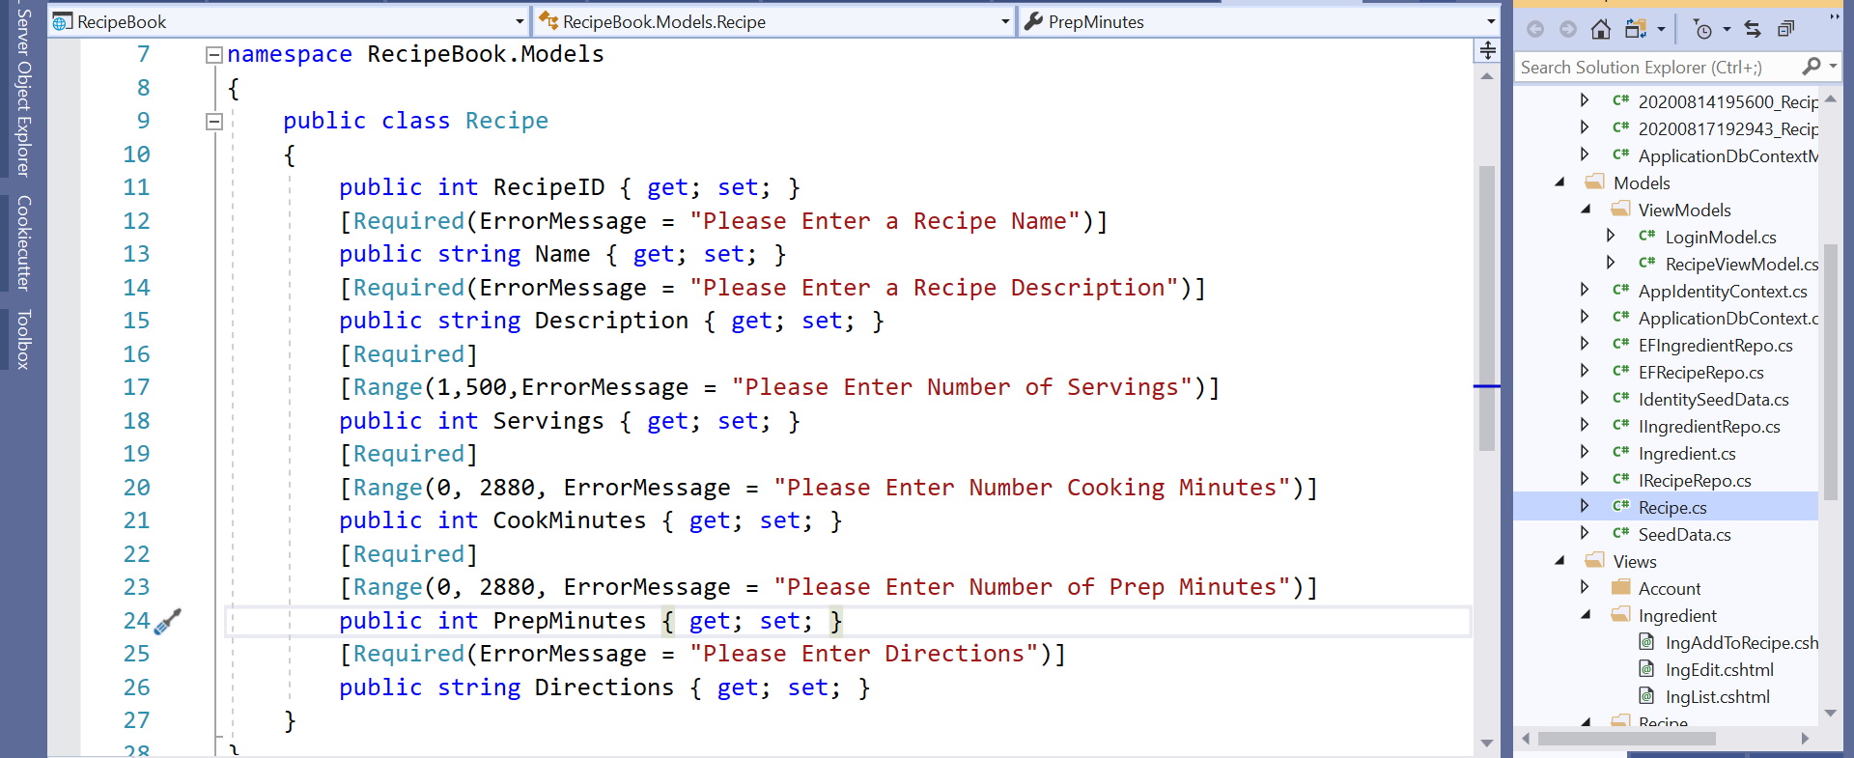
Recipe Update:
Removed string Ingredient Property

Slide 8
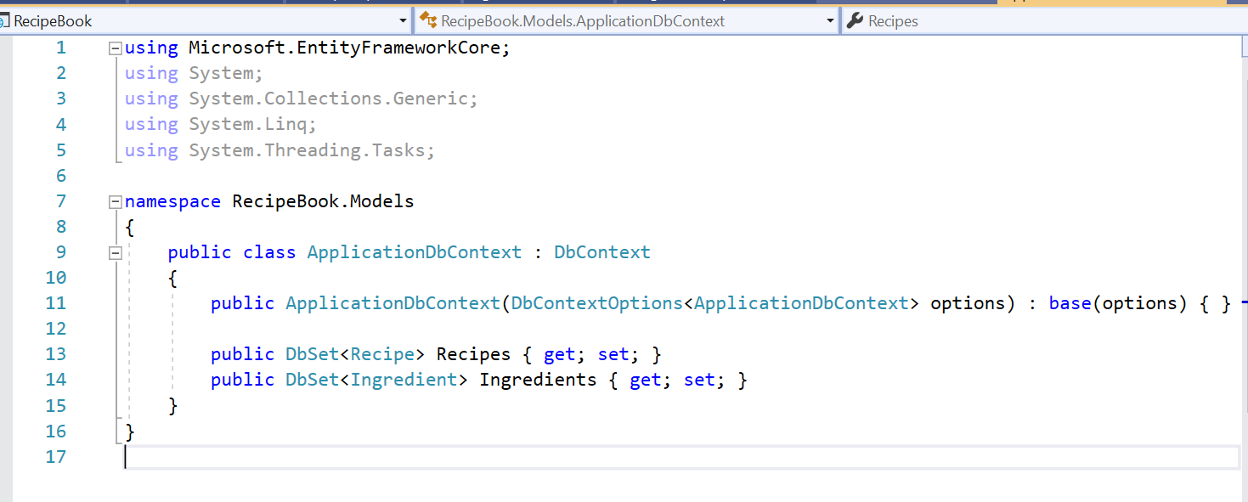
ApplicationDbContext Update:
Added DbSet for Ingredients

Slide 9
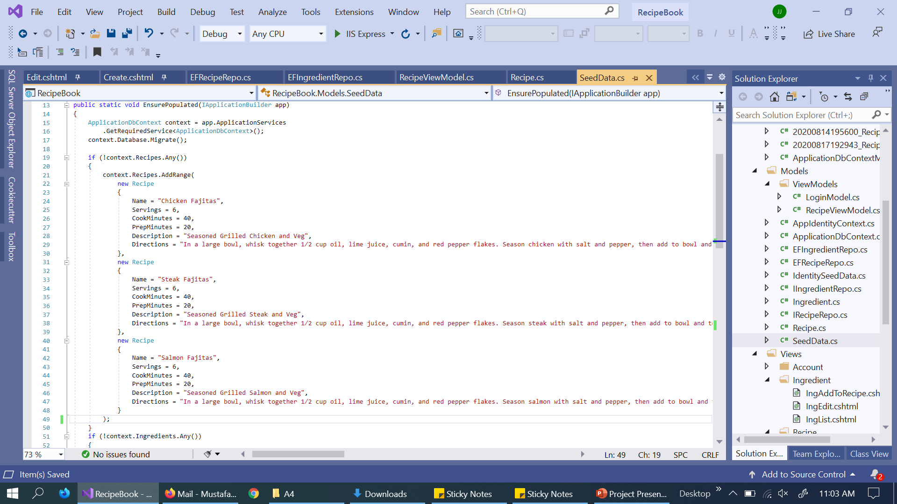
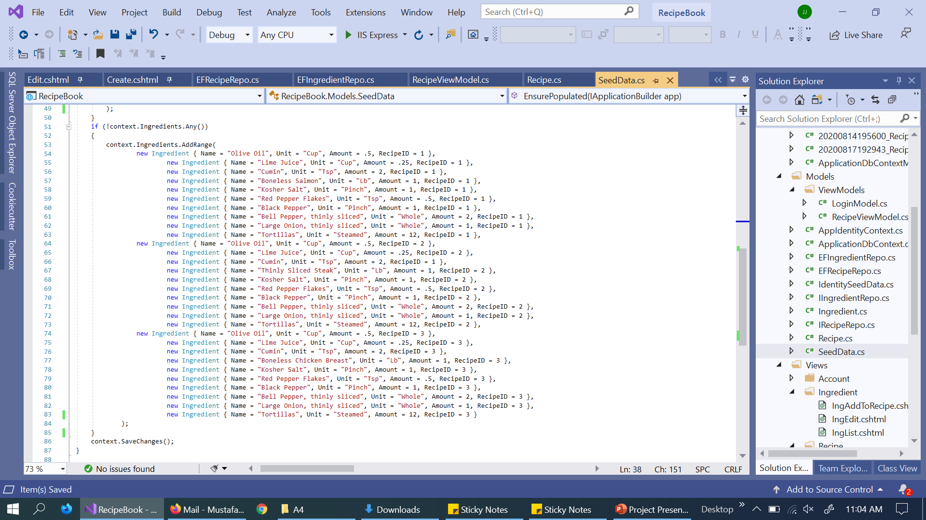
SeedData Update:
Added SeedData for Ingredient Context and removed Ingredient SeedData from Recipe Context

Slide 10
CONTROLLERS:
IngredientController
RecipeController Update

Slide 11
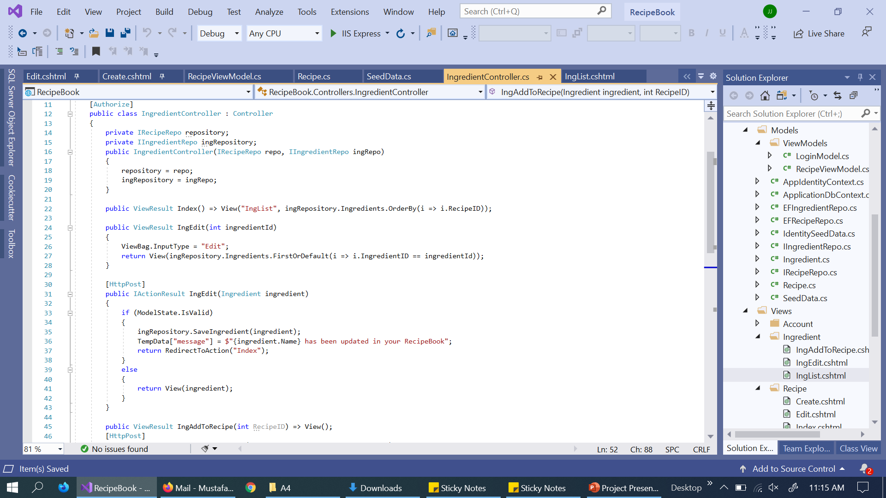
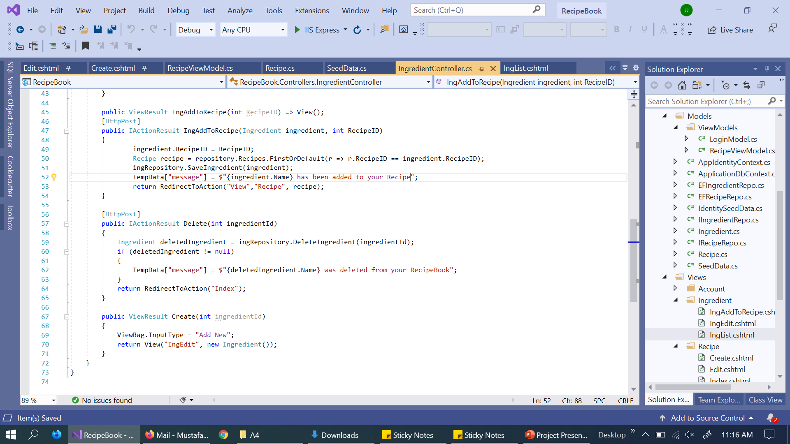
IngredientController:
Created CRUD controller for viewing Ingredient list, Deleting single Ingredient, Editing Ingredient and Adding Single Ingredient to a Recipe

Slide 12
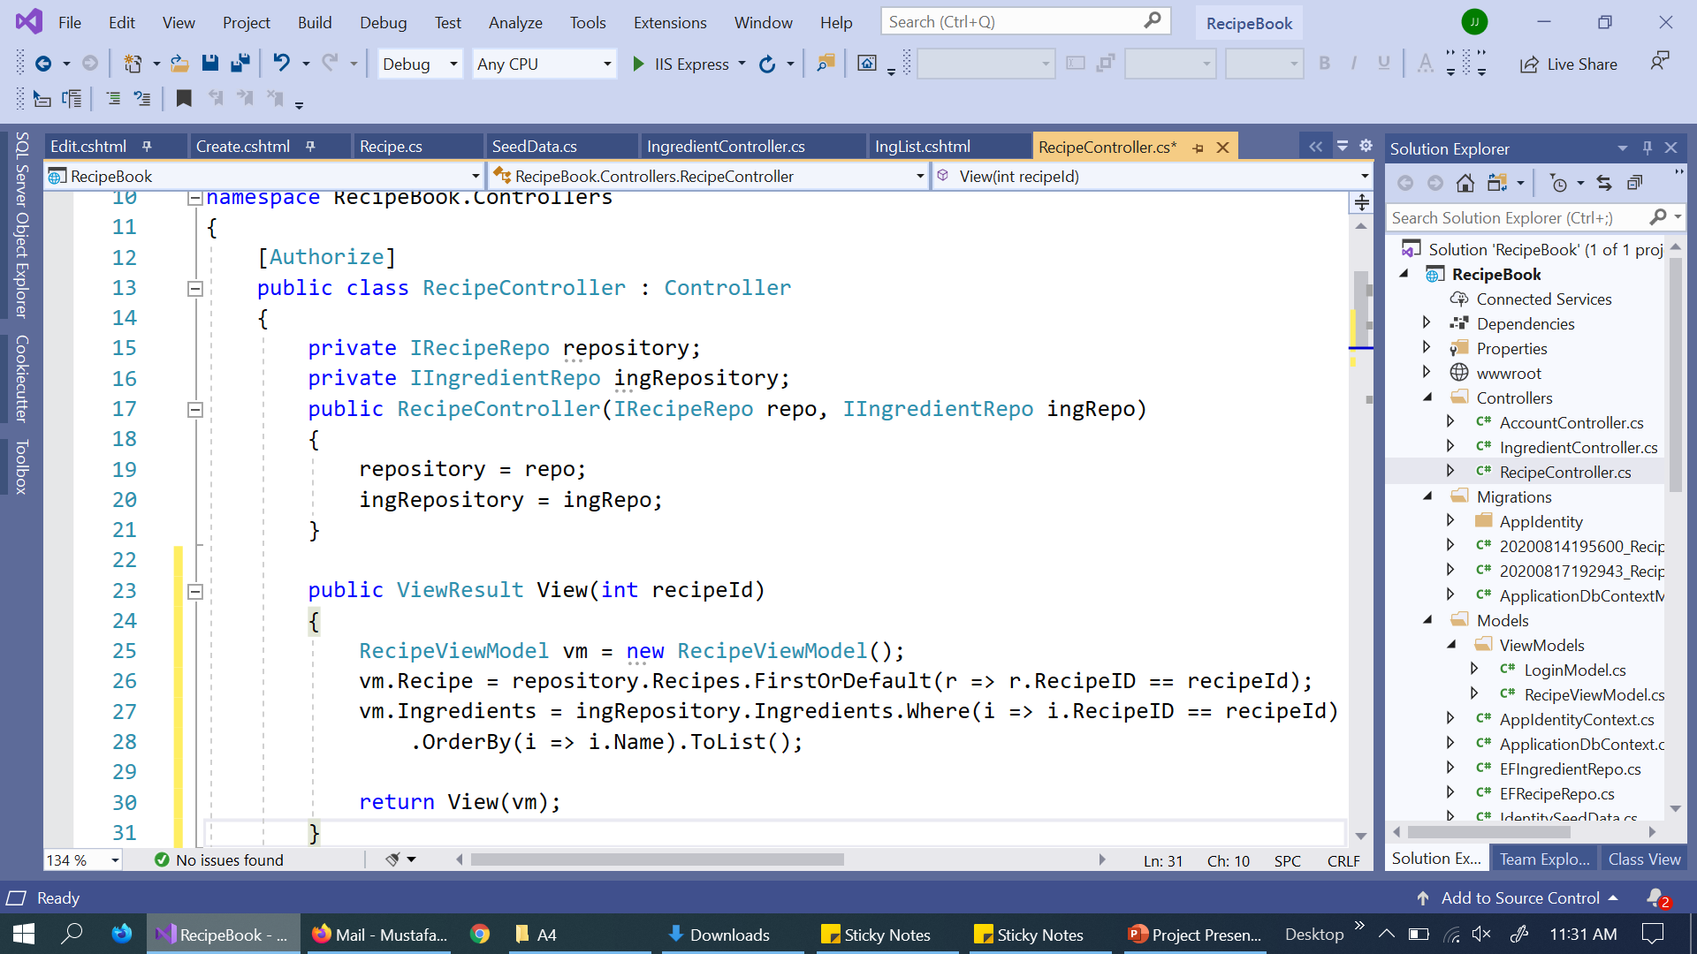
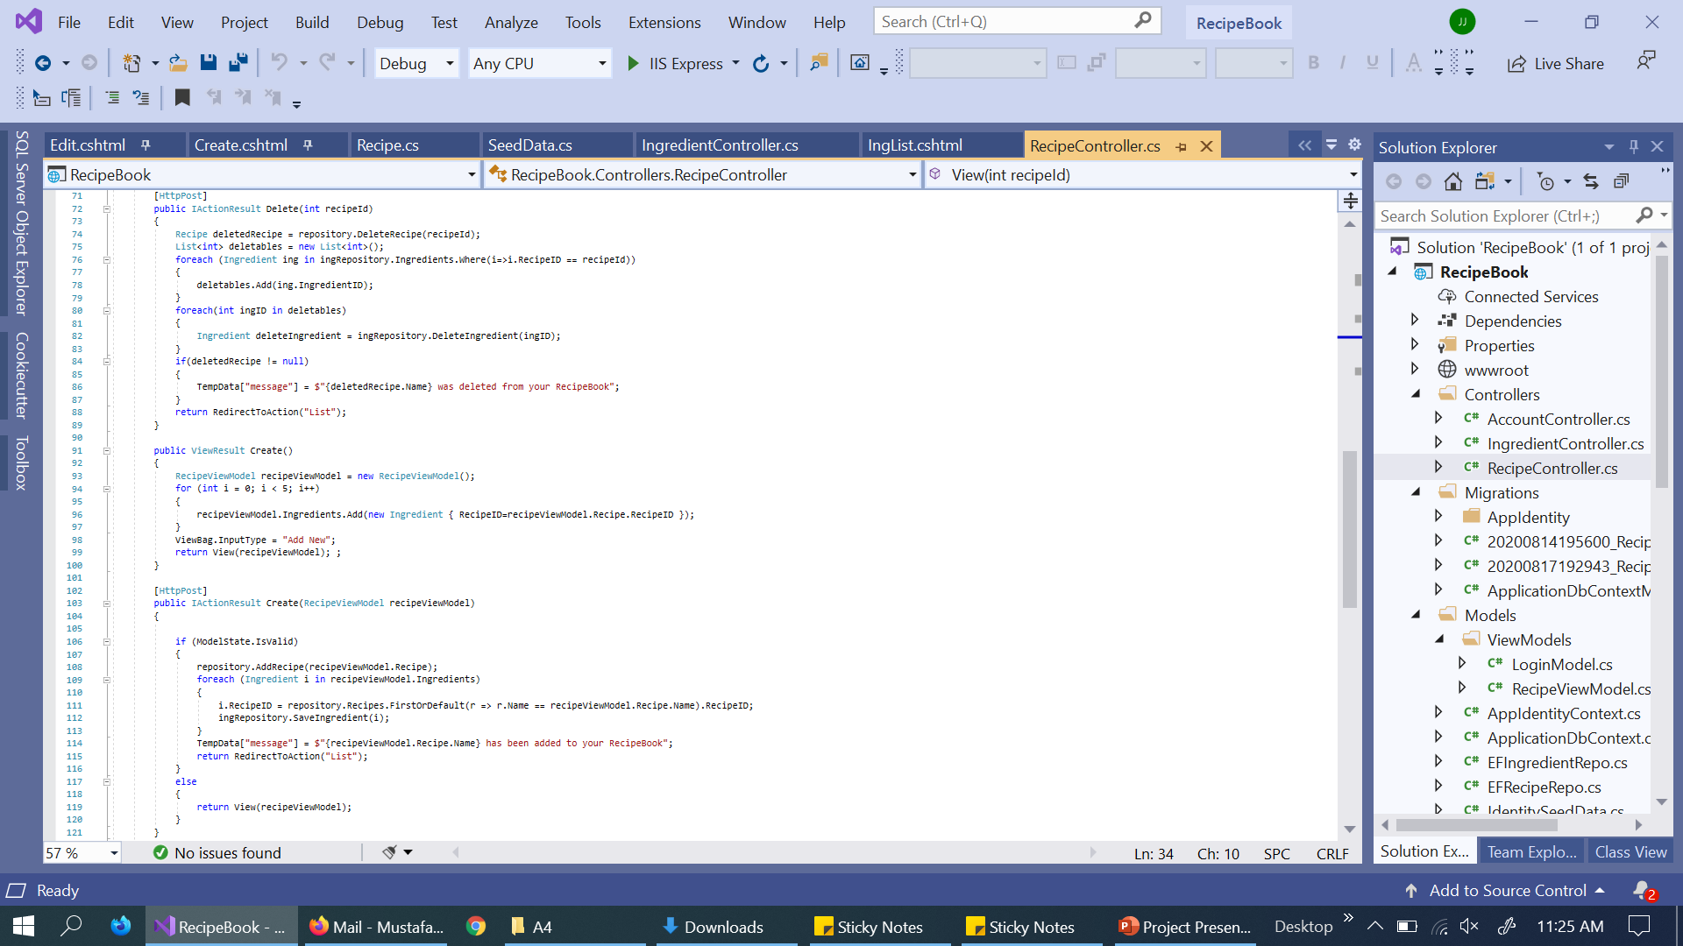
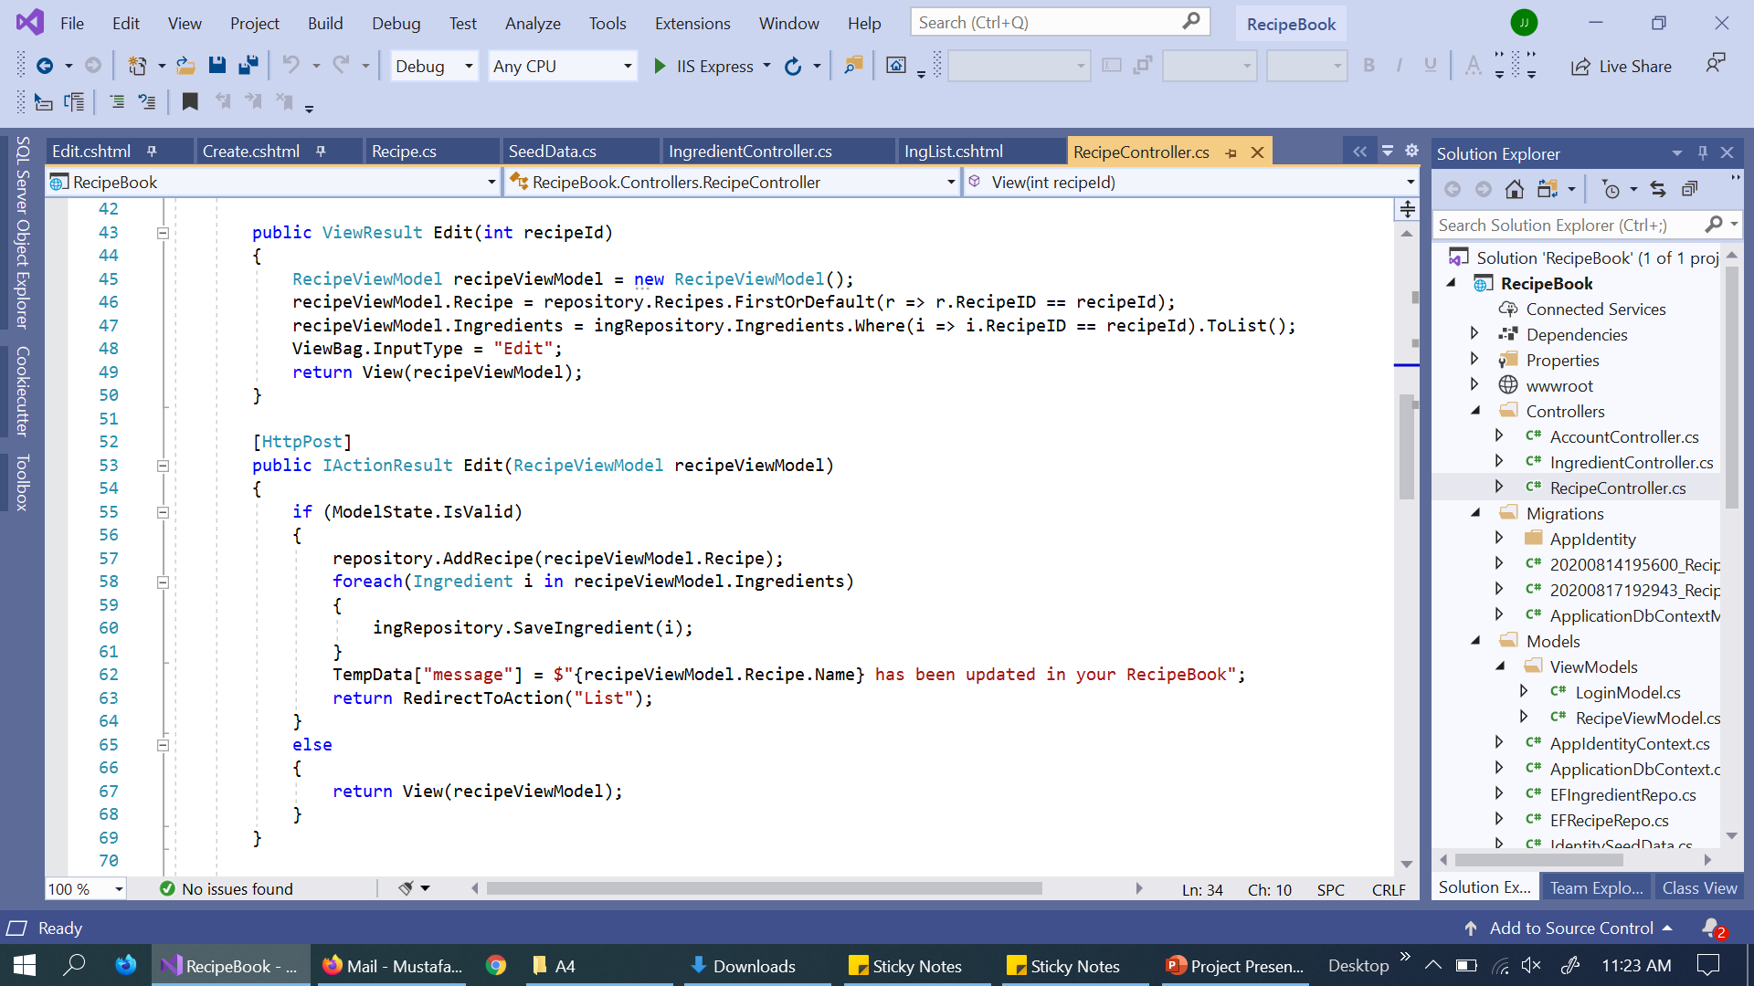
RecipeController Update:
Added IIngredientRepo access. Implemented RecipeViewModel in all Recipe CRUDs except list. Deleting Recipe will delete its Ingredients too.

Slide 13
VIEWS:
Ingredient/
ListIngredient
EditIngredient
AddIngredientToRecipe
Recipe/
Updated CreateRecipe
Updated EditRecipe
Updated ViewRecipe
Shared/
FullRecipeInput (Partial)

Slide 14
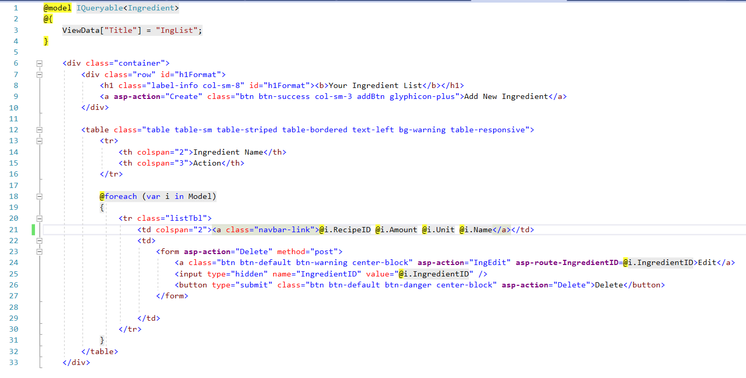
Ingredient/List:

Slide 15
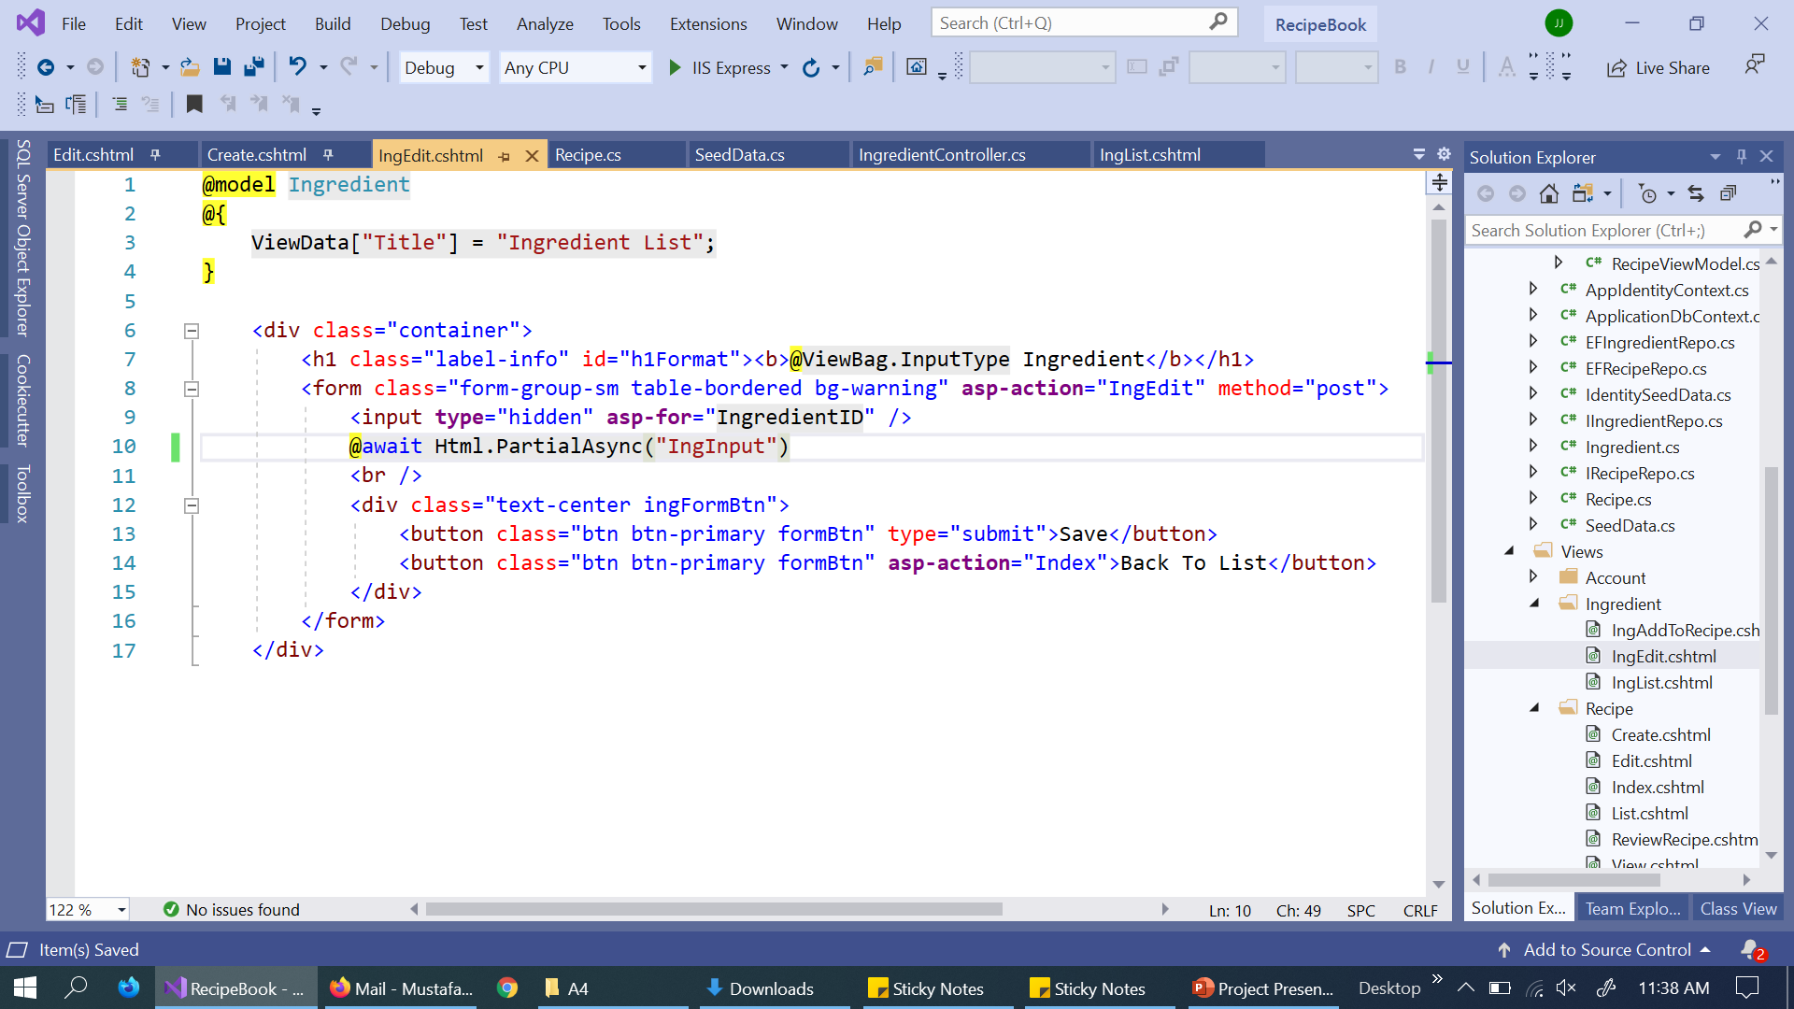
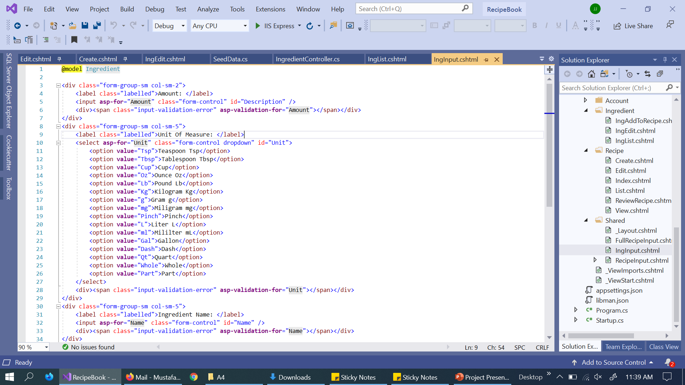
Ingredient/Edit:
Edit calls partial View for Single Ingredient input

Slide 16
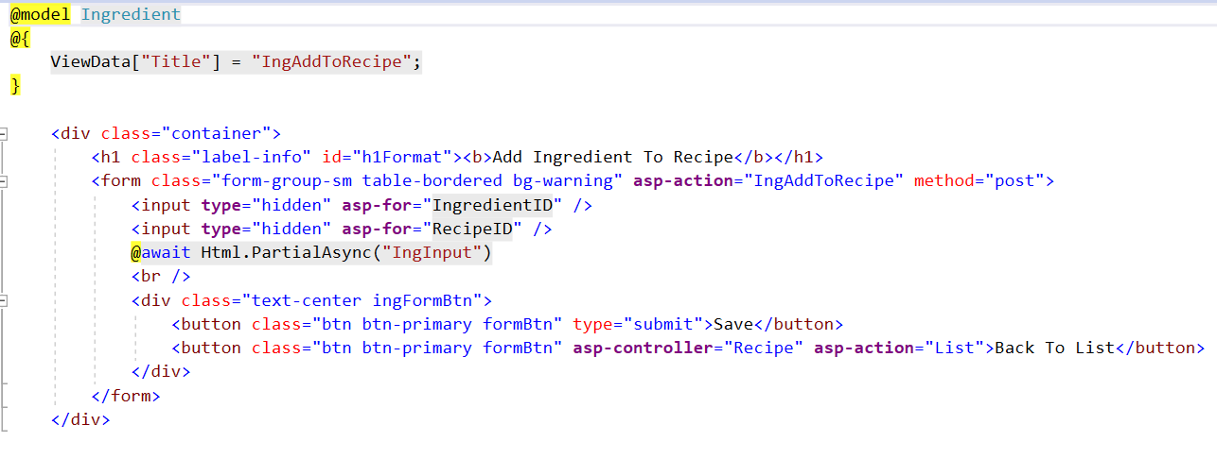
Ingredient/AddIngredientToRecipe:
AddIngredientToRecipe calls partial View for Single Ingredient input

Slide 17
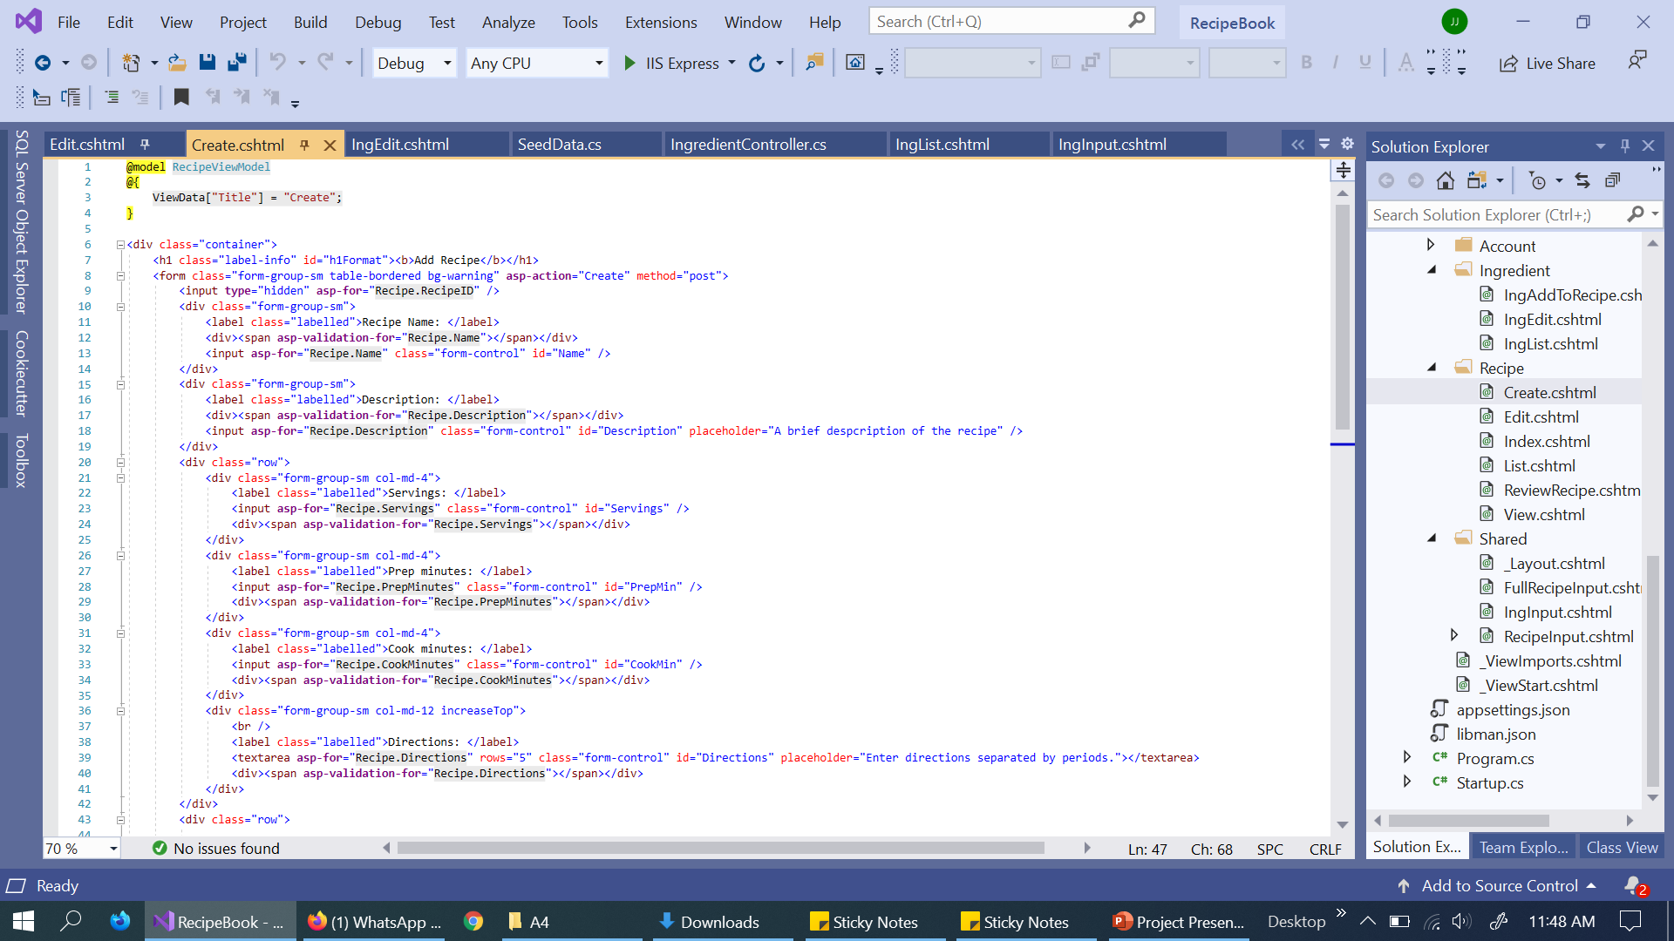
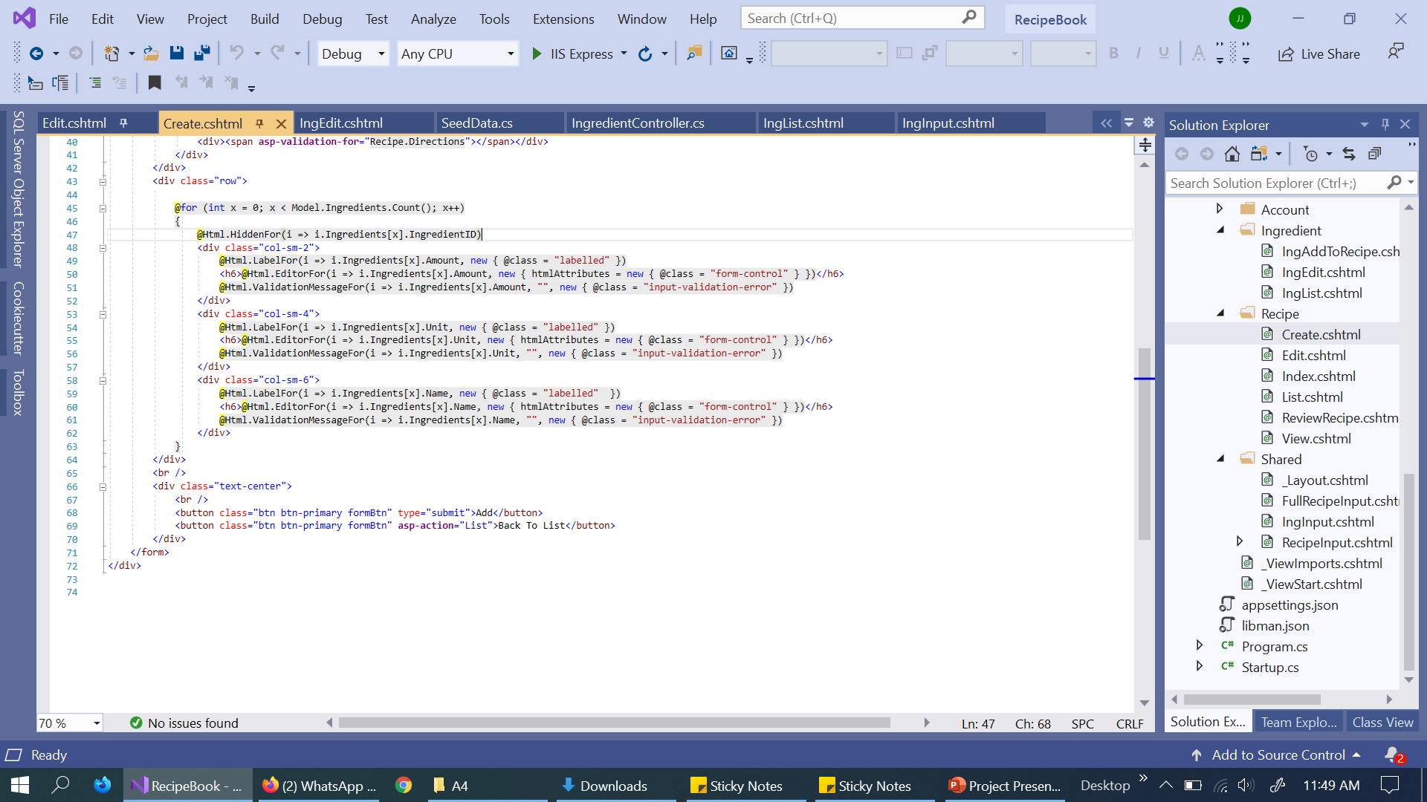
Recipe/Create Update:

Slide 18
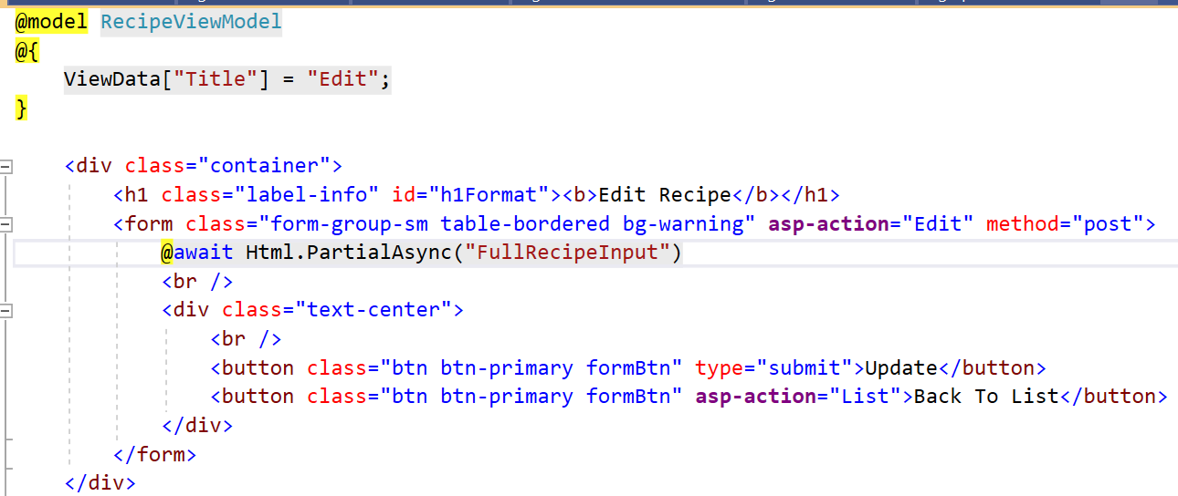
Recipe/Edit Update:
Edit calls FullRecipeInput partial view for recipe input

Slide 19
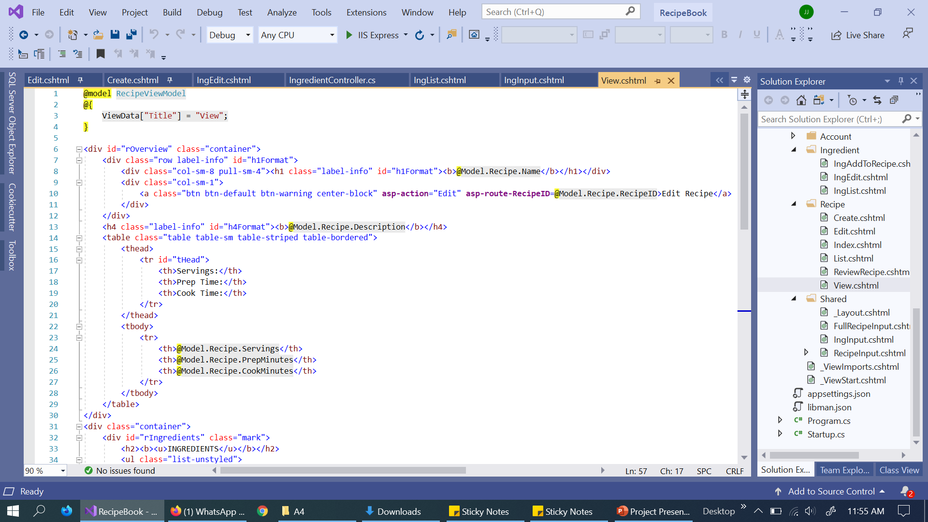
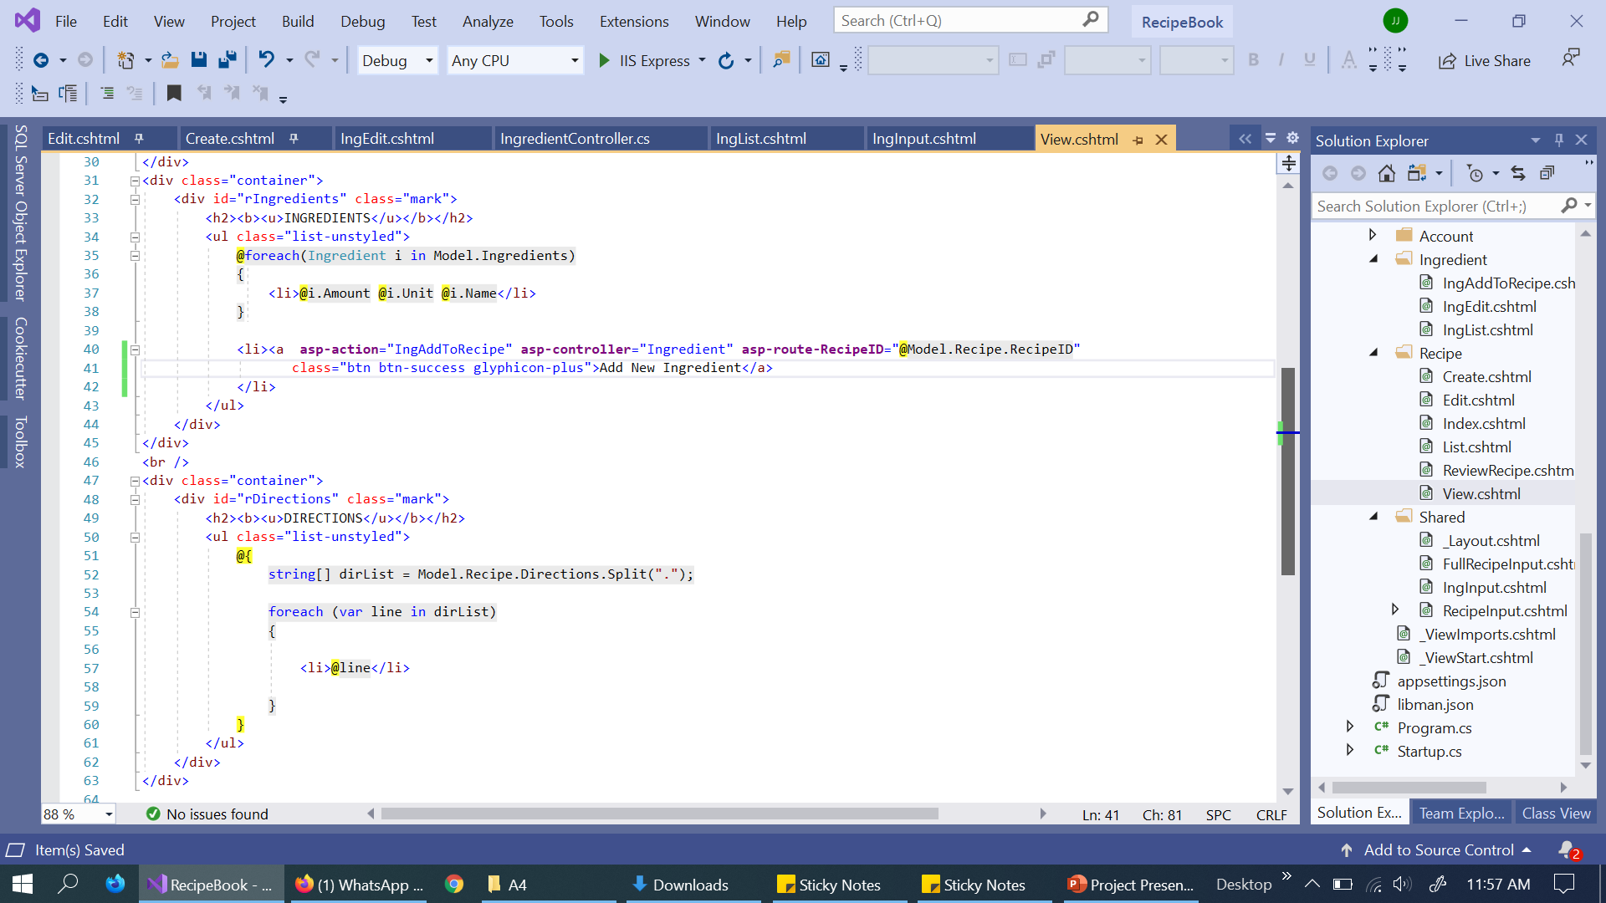
Recipe/View Update:

Slide 20
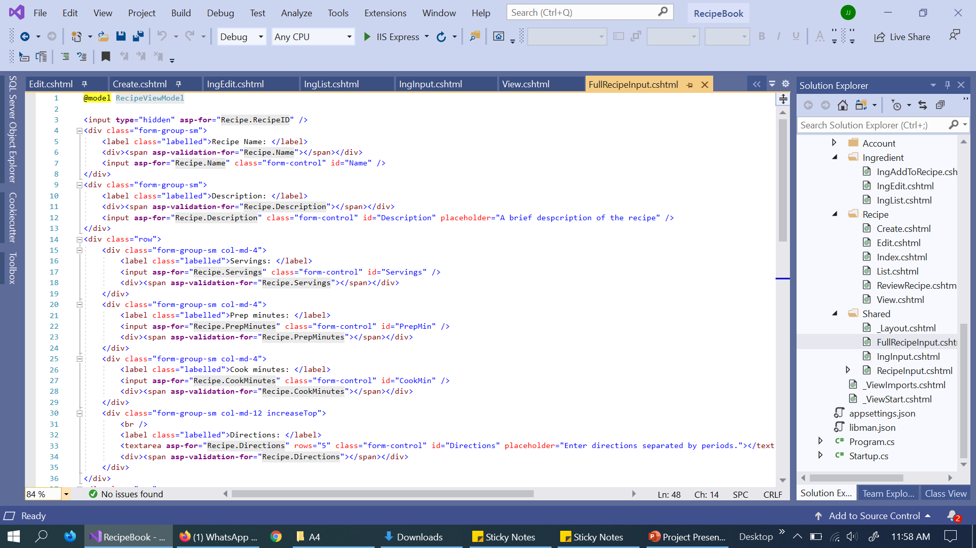
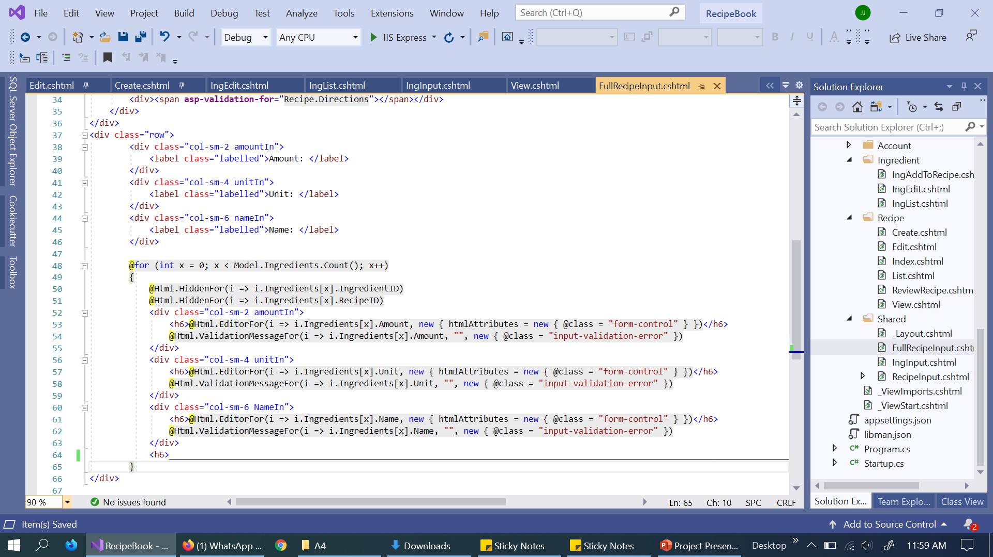
Shared/FullRecipeInput:

